Slide 1
Crime rate analysis
Kota punnam roll number:160123737118
Guided by: DR.rama krishna

Slide 2
Abstract
This project studies crime data in India to find patterns and trends over the years. We used Python to clean the data and make graphs that show how crime has changed in different states and over time. The aim is to understand which areas have more crime and how it has increased or decreased. These insights can help the police and government make better plans to reduce crime.

Slide 3
Data analysis & models
Descriptive Analysis
Summarizes and visualizes crime counts by year, state, and type.
Tools: Pandas, Matplotlib, Seaborn.
Trend Analysis (Time Series)
Analyzes how total crime changes over time.
Helps identify rising or declining crime years
Comparative Analysis
Compares crime rates between states or regions.
Visualized using bar graphs or heatmaps.

Slide 4
Tools and libraries used
Python: Used for coding
Pandas: Helps to read and work with data
NumPy: Helps with math and numbers
Matplotlib : Used to make graphs
Power point: Used to make this presentation
Kaggle:for Hospital DataSet

Slide 5
Visuals and Graphs
Bar Chart: Average bill for each age group
Pie Chart: Number of male vs female patients
Line Graph: Number of patients each month
Box Plot: Shows bills with very high or low values

Slide 6
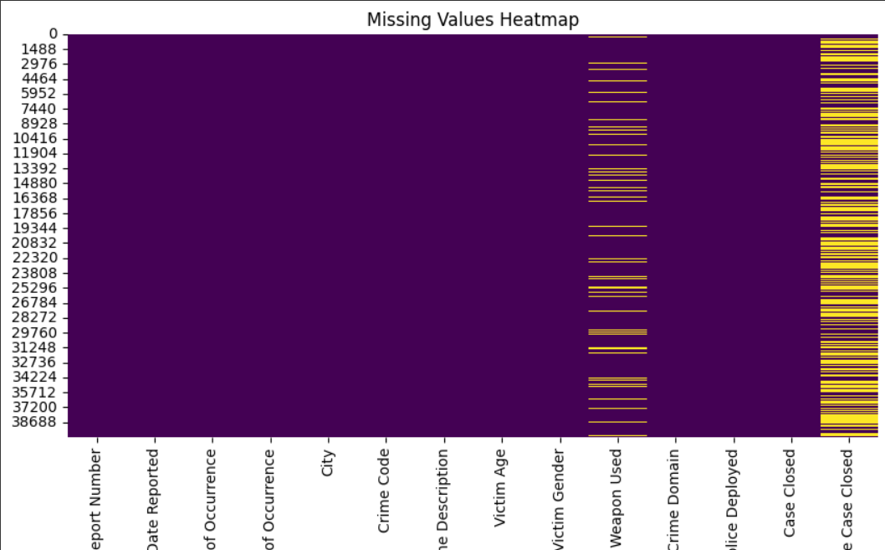
Result

Slide 7
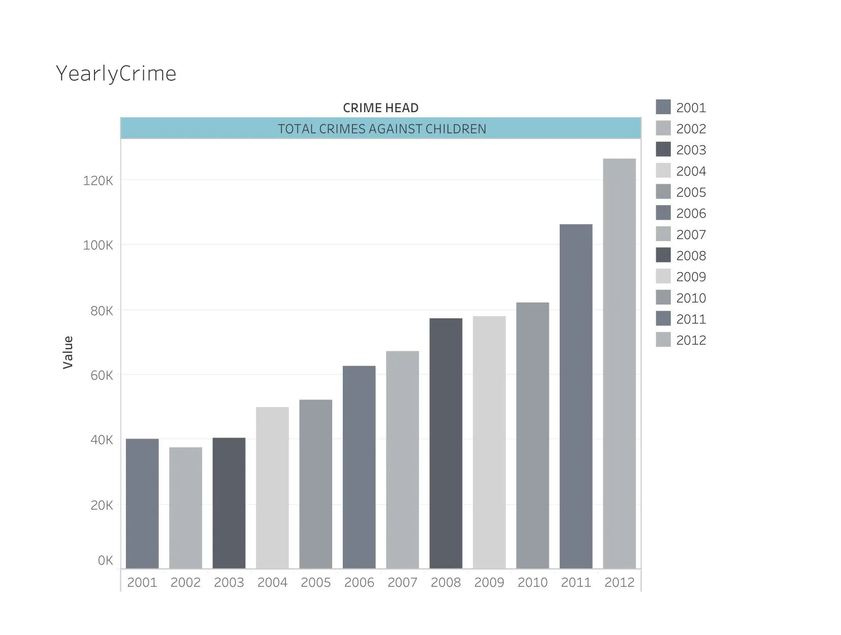
Result

Slide 8
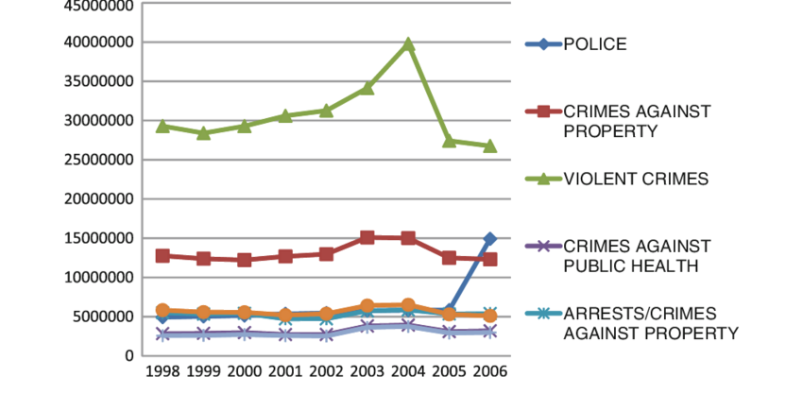
Result

Slide 9
Summary and conclusion
The analysis of India's crime data reveals key trends and patterns over time. Certain states consistently report higher crime numbers, highlighting regional hotspots. The yearly trend shows how crime levels have changed, helping us understand the effectiveness of law enforcement and policy changes. Visualizing this data makes it easier to identify problem areas and supports better decision-making for safety and crime prevention. Overall, data analysis plays a crucial role in creating a more informed and secure society

